Slide 1
Content list
Abstract Class
Concrete Class
Interface
Generic-Programming

Slide 2
Pure-Virtual destructor
class Base {
public:
virtual ~Base()=0; // Pure virtual destructor
};
class Derived : public Base
{
public:
~Derived()
{
std::cout << "~Derived() is executed";
}
};
int main()
{
Base *b=new Derived();
delete b;
return 0;
}
test.cpp:(.text$_ZN7DerivedD1Ev[__ZN7DerivedD1Ev]+0x4c):
undefined reference to `Base::~Base()'

Slide 3
Pure-Virtual destructor
class Base{
public:
virtual ~Base()=0; // Pure virtual destructor
};
Base::~Base() {
std::cout << "Pure virtual destructor is called";
}
class Derived : public Base
{
public:
~Derived()
{
std::cout << "~Derived() is executed\n";
}
};
int main()
{
Base *b = new Derived();
delete b;
return 0;
}
~Derived() is executed
Pure virtual destructor is called

Slide 4
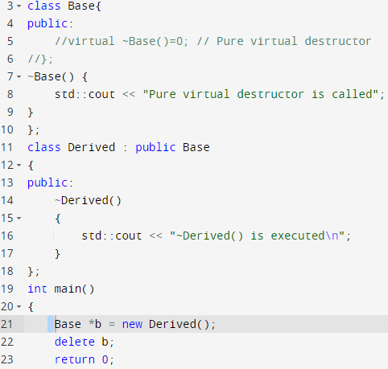
Case-01
A base class pointer create a dynamic child object.

Slide 5
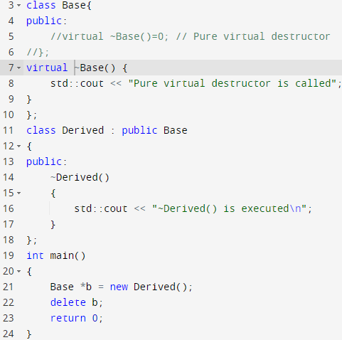

Case-01
A base class pointer create a dynamic child object. With virtual keyword

Slide 6
Create a base class called shape. Use this class to store two double type values that could be used to compute the area of figures. Derive two specific classes called triangle and rectangle from the base shape. Add to the base class, a member function get_data() to initialize base class data members and another member function display_area() to compute and display the area of figures. Make display_area() as a virtual function and redefine this function in the derived classes to suit their requirements.
Using these three classes, design a program that will accept dimensions of a triangle or a rectangle interactively, and display the area.
Remember the two values given as input will be treated as lengths of two sides in the case of rectangles and as base and height in the case of triangles, and used as follows:
Area of rectangle = x * y
Area of triangle = ½ * x * y

Slide 7

Example
Define a class String. Use overload == operator to compare two strings.
class string
{
char str[1000];
public:
void input(){gets(str);}
int operator==(string s2);
};
int string::operator==(string s2)
{
int t= strcmp(str,s2.str);
if(t==0)
t=1;
else
t=0;
return t;
}
int main()
{
char st1[1000],st2[1000];
string s1,s2;
cout<<" Enter 1st string : ";
s1.input();
cout<<" enter 2nd string : ";
s2.input();
if(s1==s2)
cout<<" Two strings are equal ";
else
cout<<" Two string are not equal ";
return 0;
}

Slide 8
Week Ten– Class Two

Slide 9
Abstract Class
A class with at least one pure virtual function or abstract function is called abstract class
Abstract class is used in situation, when we have partial set of implementation of methods in a class.
Abstract classes provide an generic base class that can be used by concrete classes to provide an interface and/or implementation.

Slide 10
Abstract Class-Cont.
For example, consider a class have four methods. Out of four methods, we have an implementation of two methods and we need derived class to implement other two methods. In these kind of situations, we should use abstract class.
Base
Child
Method-01
Method-03
Method-02
Method-04

Slide 11
Abstract Classes
We can't create an object of abstract class because it has partial implementation of methods.
Abstract function doesn't have body
We must implement all abstract functions in derived class.

Slide 12
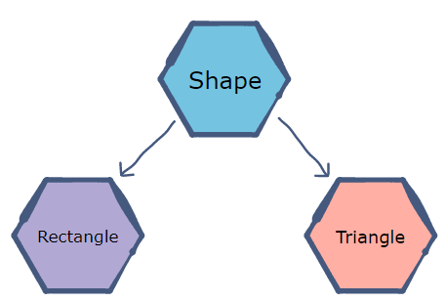
Abstract Clas - Example
A Vehicle parent class with Truck and Motorbike inheriting from it is an abstraction that easily allows more vehicles to be added. However, even though all vehicles have wheels, not all vehicles have the same number of wheels – this is where a pure virtual function is needed.

Slide 13
class Shape {
public:
virtual int Area() = 0;
// Pure virtual function is declared as follows.
// Function to set width.
void setWidth(int w) {
width = w;
}
// Function to set height.
void setHeight(int h) {
height = h;
}
protected:
int width;
int height;
};
// A rectangle is a shape; it inherits shape.
class Rectangle: public Shape {
public:
// The implementation for Area is specific to a rectangle.
int Area() {
return (width * height);
}
};
// A triangle is a shape too; it inherits shape.
class Triangle: public Shape {
public:
// Triangle uses the same Area function but implements it to
// return the area of a triangle.
int Area() {
return (width * height)/2;
}
};
int main() {
Rectangle R;
Triangle T;
R.setWidth(5);
R.setHeight(10);
T.setWidth(20);
T.setHeight(8);
cout << "The area of the rectangle is: " << R.Area() << endl;
cout << "The area of the triangle is: " << T.Area() << endl;
}

Slide 14
Concepts!
1) A class is abstract if it has at least one pure virtual function.
2) We can have pointers and references of abstract class type.
3) If we do not override the pure virtual function in derived class, then derived class also becomes abstract class.
4) An abstract class can have constructors.

Slide 15
Can a destructor be pure virtual in C++?
Yes, it is possible to have pure virtual destructor.
if a class contains a pure virtual destructor, it must provide a function body for the pure virtual destructor.
You may be wondering why a pure virtual function requires a function body. ?
The reason is because destructors (unlike other functions) are not actually ‘overridden’, rather they are always called in the reverse order of the class derivation.
This means that a derived class’ destructor will be invoked first, then base class destructor will be called.
If the definition of the pure virtual destructor is not provided, then what function body will be called during object destruction?
Therefore the compiler and linker enforce the existence of a function body for pure virtual destructors.

Slide 16
Concrete Class
An abstract class is meant to be used as the base class from which other classes are derived.
The derived class is expected to provide implementations for the methods that are not implemented in the base class.
A derived class that implements all the missing functionality is called a concrete class
A concrete class is an ordinary class which has no purely virtual functions and hence can be instantiated.

Slide 17
class Abstract {
private:
string info;
public:
virtual void printContent() = 0;
};
int main()
{
/*
* Abstract a;
* Error : Abstract Instance Creation Failed
*/
string s;
s = "Object Creation Date : 23:26 PM 15 Dec 2013";
Concrete c(s);
c. printContent();
}
class Concrete {
private:
string info;
public:
Concrete(string s) : info(s) { }
void printContent() {
cout << "Concrete Object Information\n" << info << endl;
}
};

Slide 18
Example
Write a program to create a class name with A that use the constructors of the abstract class to find the sum of two numbers and display the result with this string “the sum is 9”. Base class constructor display the message “hello I am the constructor of base class”

Slide 19
Solution
int main(void)
{
B obj(4, 5);
obj.test();
return 0;
}
#include <iostream>
using namespace std;
class A {
public:
int a, b, c;
virtual void test() = 0;
A(int a, int b)
{ cout << "Hello I am the constructor" << endl; } };
class B : public A {
public: B(int i, int j) : A(a, b)
{ a = i; b = j; c = a + b; }
void test()
{ cout << "The sum is = " << c << endl; } };

Slide 20

We can have pointers and references of abstract class type.
using namespace std;
class Base
{
public:
virtual void fun() = 0;
int getX() {cout << "get() called"; }
};
// This class inherits from Base and implements fun()
class Derived: public Base
{
int y;
public:
void fun() { cout << "fun() called"; }
};
int main(void)
{
Base obj;
obj.getX();// genrate compile time error
Base* b;
Derived d;
b= &d;
d.fun();
return 0;
}

Slide 21
Why can't we create Object of an Abstract Class?
When we create a pure virtual function in Abstract class, we reserve a slot for a function in the VTABLE(studied in last topic), but doesn't put any address in that slot. Hence the VTABLE will be incomplete.
As the VTABLE for Abstract class is incomplete, hence the compiler will not let the creation of object for such class and will display an error message whenever you try to do so.

Slide 22
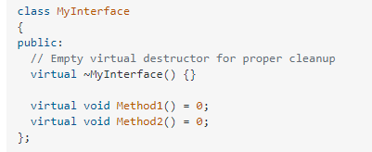
Interface
An interface does not have implementation of any of its methods, it can be considered as a collection of method declarations
In C++, an interface can be simulated by making all methods as pure virtual.

Slide 23
Interface vs Abstract Classes
Abstract classes:
These are base classes where you have to derive from them and then implement the pure virtual functions.
Interfaces:
These are 'empty' classes where all functions are pure virtual and hence you have to derive and then implement all of the functions.

Slide 24
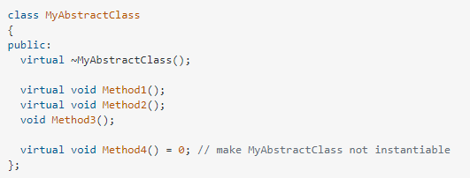
Interface vs Abstract Classes

Slide 25
Week Ten– Class Three

Slide 26
Generic Programming!
Generic programming means that you are not writing source code that is compiled as-is but that you write "templates" of source codes that the compiler in the process of compilation transforms into source codes.
Generic programming is basically the idea that your code should be as generic as possible.
Generic programming is a style of computer programming in which algorithms are written in terms of to-be-specified-later types that are then instantiated when needed for specific types provided as parameters.

Slide 27
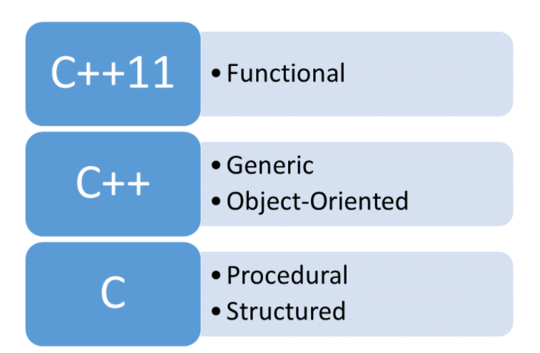
Generic Programming!
The goal of generic programming is to write code that is independent of the data types.

Slide 28
generic programming
To generate short, simple code and to avoid duplication of code, C++ provides templates to define the same piece of code for multiple data types.
With templates, programmers can define a family of functions or classes that can perform operations on different types of data.
Templates comes under the category of meta-programming and auto code generation, where the generated code is not visible in general. Through templates, C++ supports generic programming.
Generic programming is a type of programming where the programmer specifies a general code first. That code is instantiated based on the type of parameters that are passed later in the program or at execution.

Slide 29
Generics
Generics can be implemented in C++ using Templates.
Templates!

Slide 30
C++ Templates
Templates are powerful features of C++ which allows you to write generic programs. In simple terms, you can create a single function or a class to work with different data types using templates.
the simple idea is to pass data type as a parameter so that we don’t need to write the same code for different data types. For example, a software company may need sort() for different data types. Rather than writing and maintaining the multiple codes, we can write one sort() and pass data type as a parameter.

Slide 31
C++ Templates
The concept of templates can be used in two different ways:
Function Templates
Class Templates

Slide 32
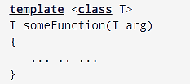
How to declare a function template?
A function template starts with the keyword template followed by template parameter/s inside < > which is followed by function declaration.
template < class Ttype> ret_type func_name(parameter_list)
{
// body of function.
}
T is a placeholder that the compiler will automatically replace with an actual data type

Slide 33
Function Templates-Generic Function
int main()
{
int i1, i2;
float f1, f2;
char c1, c2;
cout << "Enter two integers:\n";
cin >> i1 >> i2;
cout << Large(i1, i2) <<" is larger." << endl;
cout << "\nEnter two floating-point numbers:\n";
cin >> f1 >> f2;
cout << Large(f1, f2) <<" is larger." << endl;
cout << "\nEnter two characters:\n";
cin >> c1 >> c2;
cout << Large(c1, c2) << " has larger ASCII value.";
return 0;
}
This way, using only a single function template replaced three identical normal functions and made your code maintainable.
#include <iostream>
using namespace std;
// template function
template <class T>
T Large(T n1, T n2)
{
return (n1 > n2) ? n1 : n2;
}

Slide 34
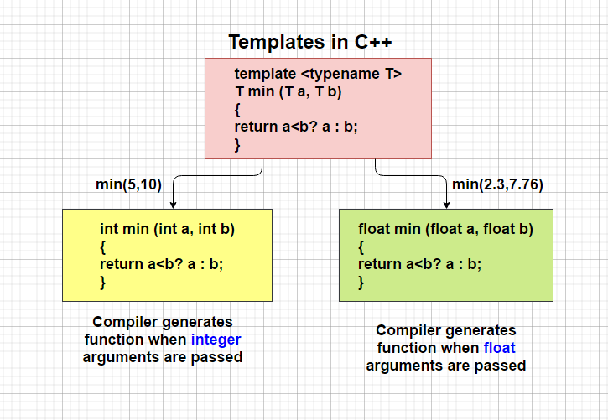
How templates work?

Slide 35
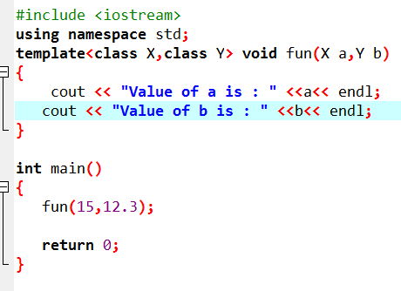
Function Templates with Multiple Parameters
template<class T1, class T2,.....>
return_type function_name (arguments of type T1, T2....)
{
// body of function.
}

Slide 36
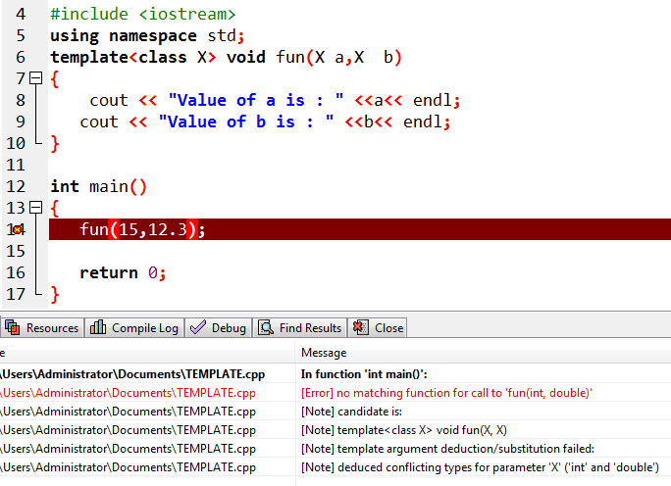
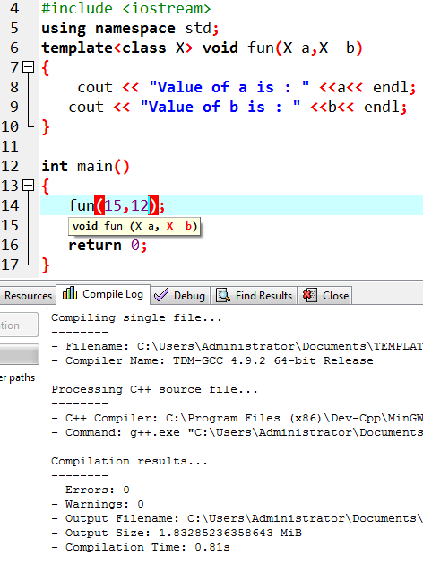
Function Templates with Multiple Parameters

Slide 37
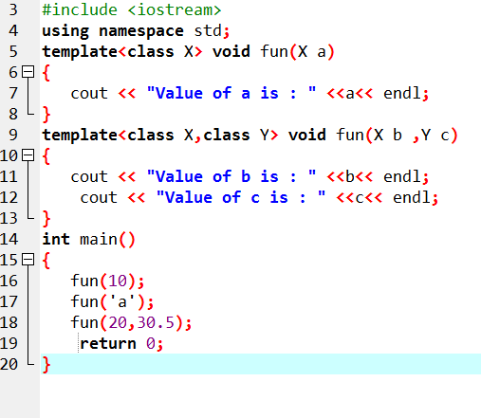
Overloading a Function Template

Slide 38
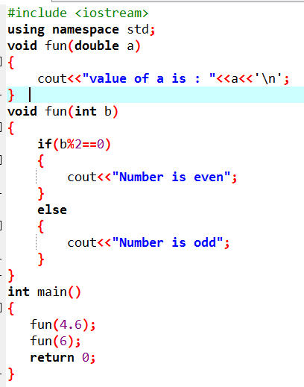
Restrictions of Generic Functions
Generic functions perform the same operation for all the versions of a function except the data type differs. Let's see a simple example of an overloaded function which cannot be replaced by the generic function as both the functions have different functionalities.

Slide 39
Class Templates-Generic Class
you can also create class templates for generic class operations.
Sometimes, you need a class implementation that is same for all classes, only the data types used are different.
Normally, you would need to create a different class for each data type OR create different member variables and functions within a single class.
This will unnecessarily bloat your code base and will be hard to maintain, as a change is one class/function should be performed on all classes/functions.
However, class templates make it easy to reuse the same code for all data types.

Slide 40
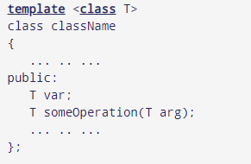
How to declare a class template?
In the above declaration, T is the template argument which is a placeholder for the data type used.
Inside the class body, a member variable var and a member function someOperation() are both of type T.

Slide 41
How to create a class template object?
className<dataType> classObject;
Example
className<int> classObject;
className<float> classObject;
className<string> classObject;

Slide 42
Example
template <class T>
class Calculator
{
private:
T num1, num2;
public:
Calculator(T n1, T n2){
num1 = n1;
num2 = n2;}
void displayResult(){
cout << "Numbers are: " << num1 << " and " << num2 << "." << endl;
cout << "Addition is: " << add() << endl;
cout << "Subtraction is: " << subtract() << endl;
cout << "Product is: " << multiply() << endl;
cout << "Division is: " << divide() << endl;}
T add() { return num1 + num2; }
T subtract() { return num1 - num2; }
T multiply() { return num1 * num2; }
T divide() { return num1 / num2; }
};
int main()
{
Calculator<int> intCalc(2, 1);
Calculator<float> floatCalc(2.4, 1.2);
cout << "Int results:" << endl;
intCalc.displayResult();
cout << endl << "Float results:" << endl;
floatCalc.displayResult();
return 0;
}

Slide 43
Template Function with Two Generic Types
You can define more than one generic data type in the template statement by using a comma-separated list
template <class T1> void myfunc(T1 a, T2 b) { cout << a << “ & ” << b << '\n'; }

Slide 44
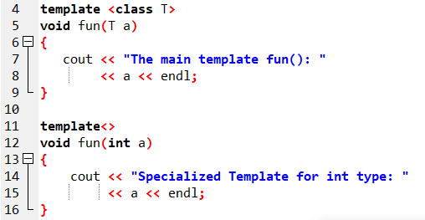
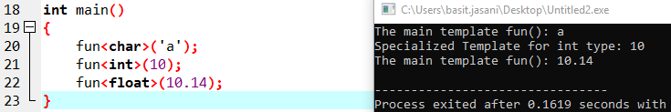
Specialized Template

Slide 45
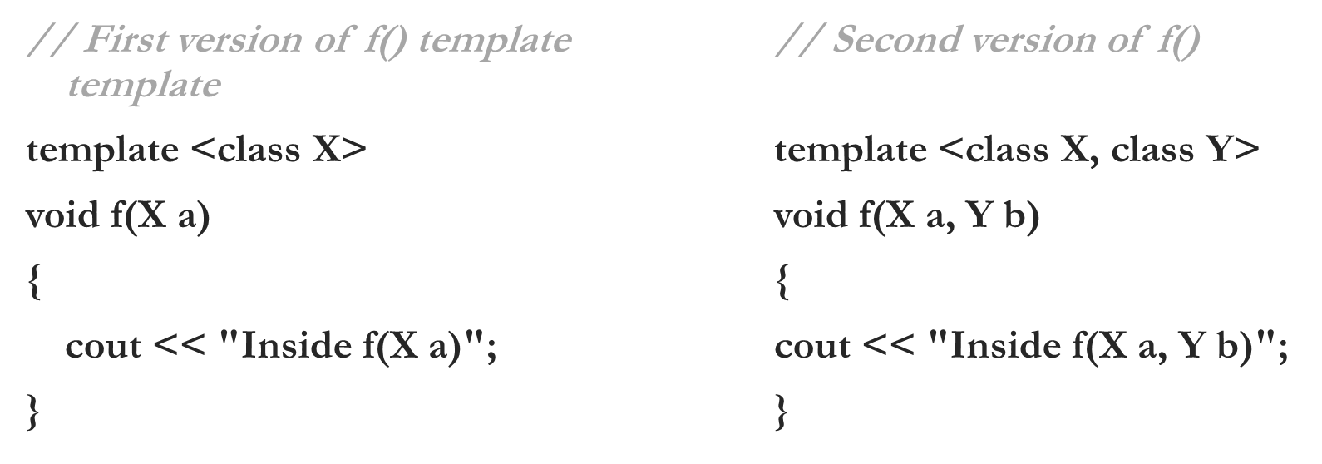
Overloading a Generic Function
In addition to creating explicit, overloaded versions of a generic function, you can also overload the template specification itself
To do so, simply create another version of the template that differs from any others in its parameter list

Slide 46
Thank you

